Slide 1











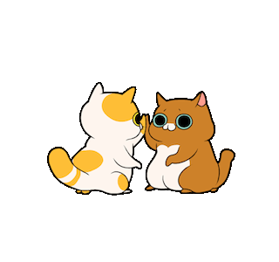



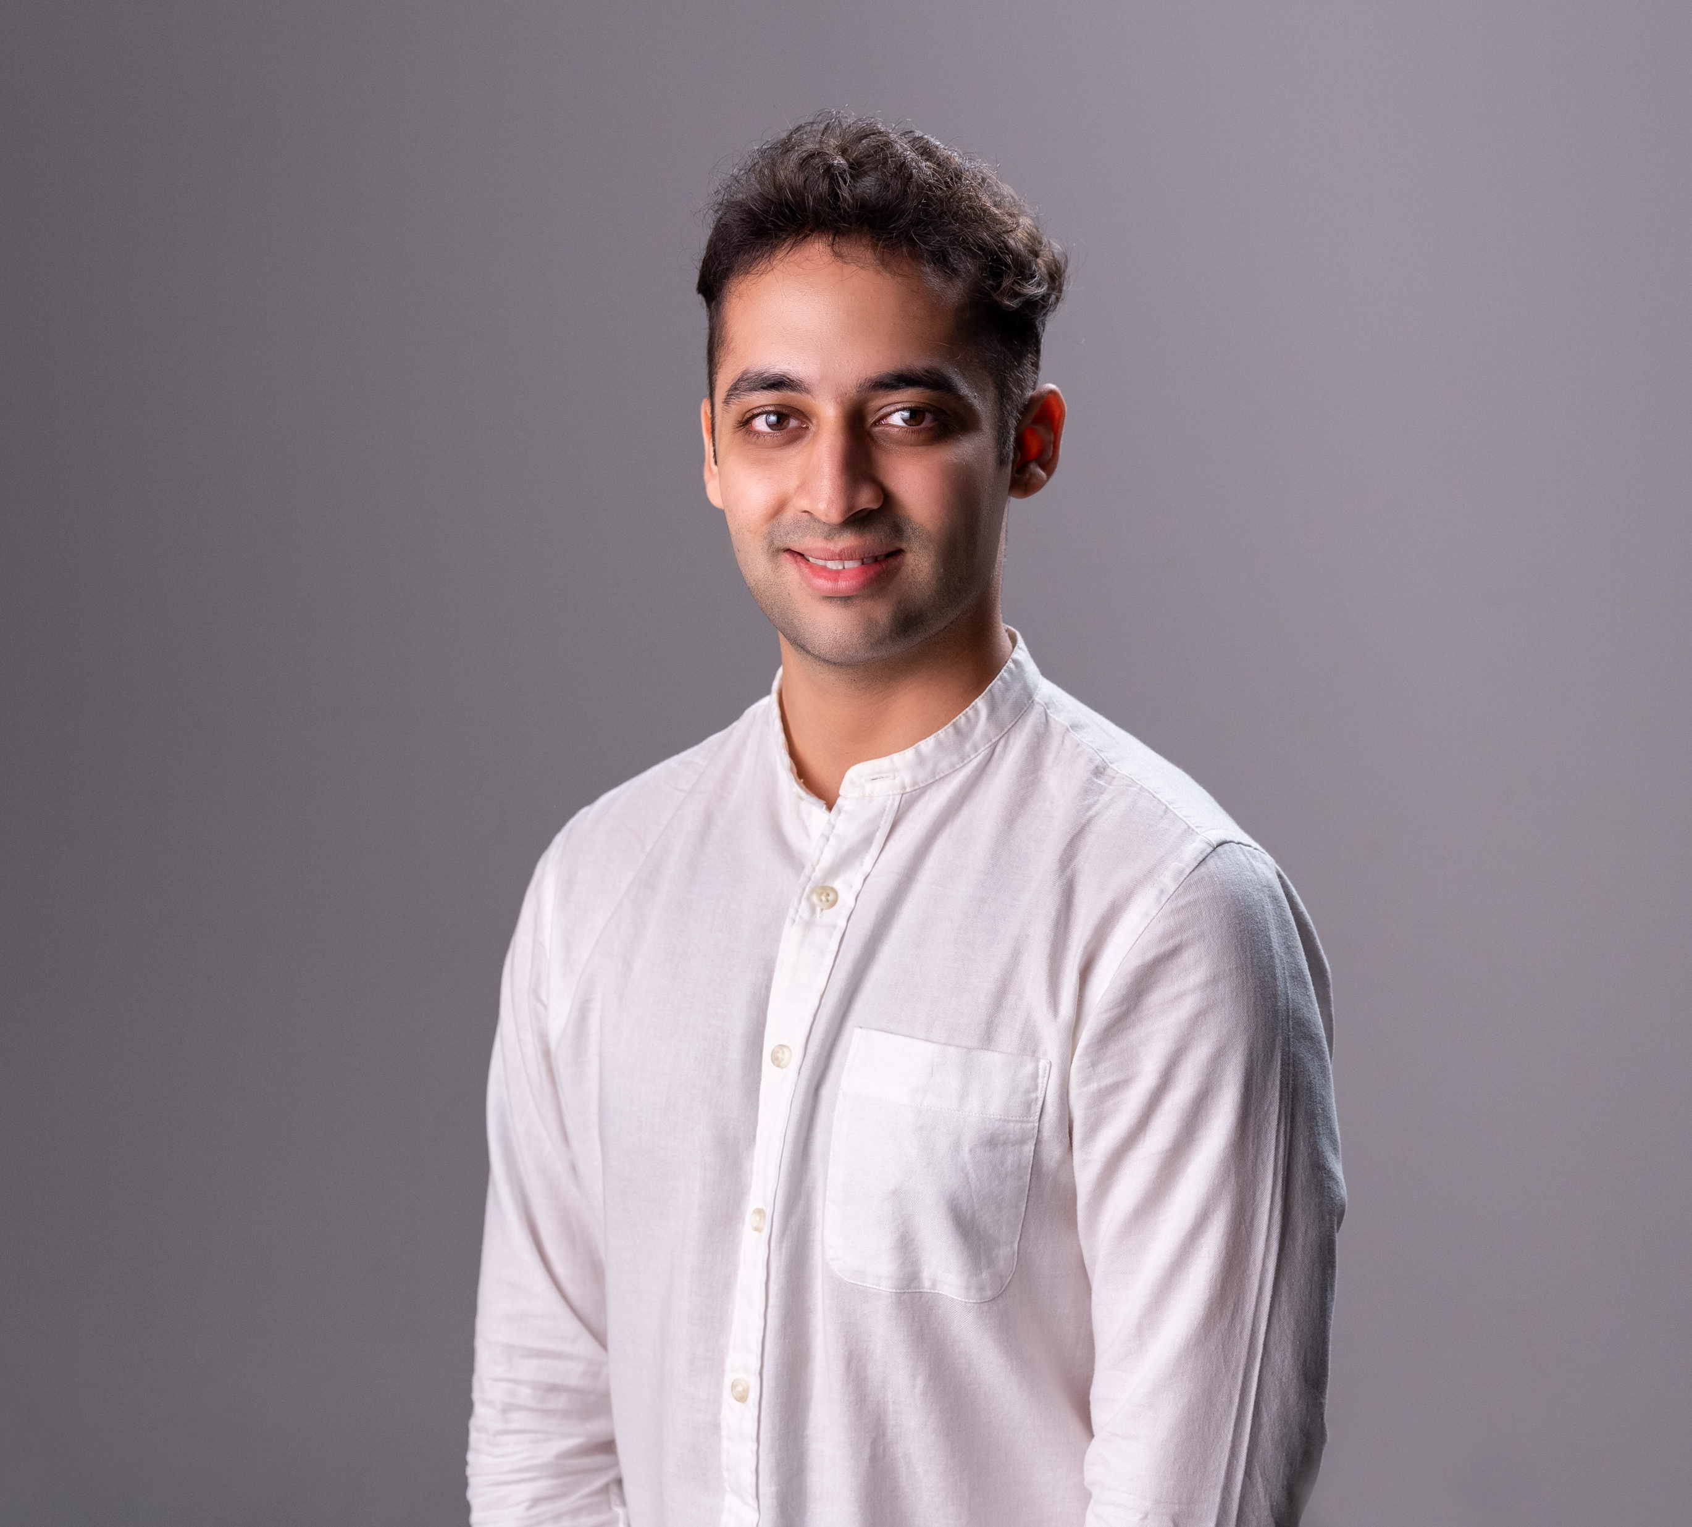
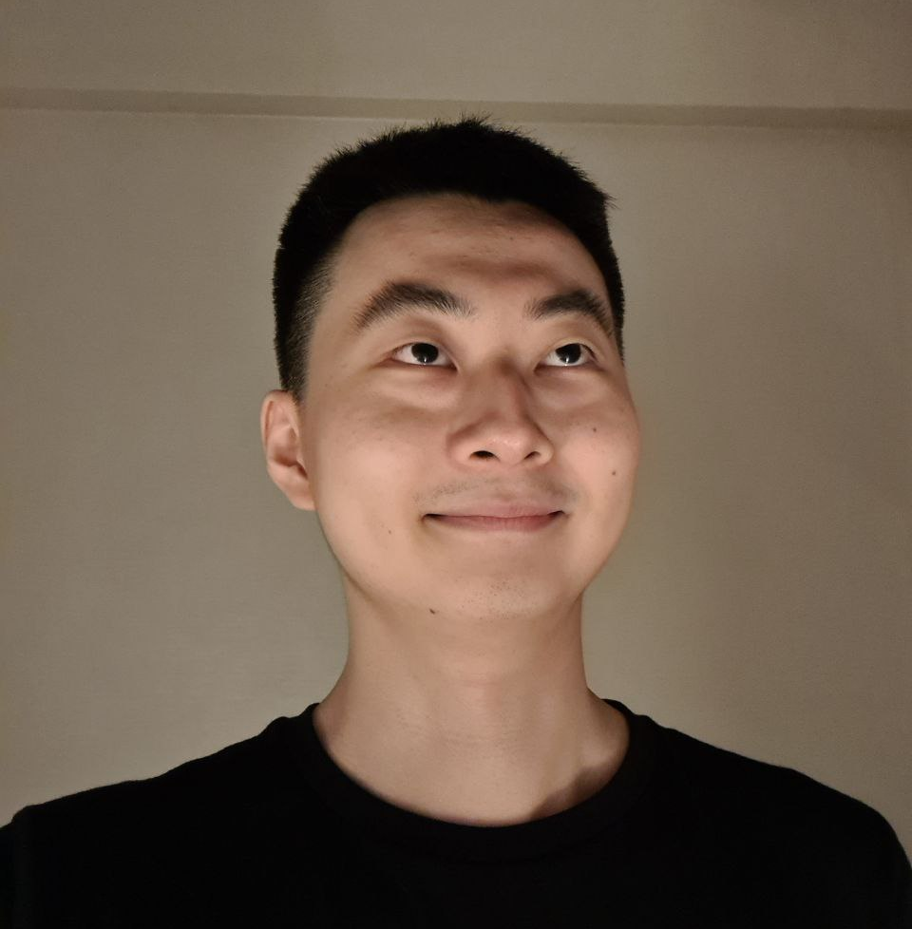
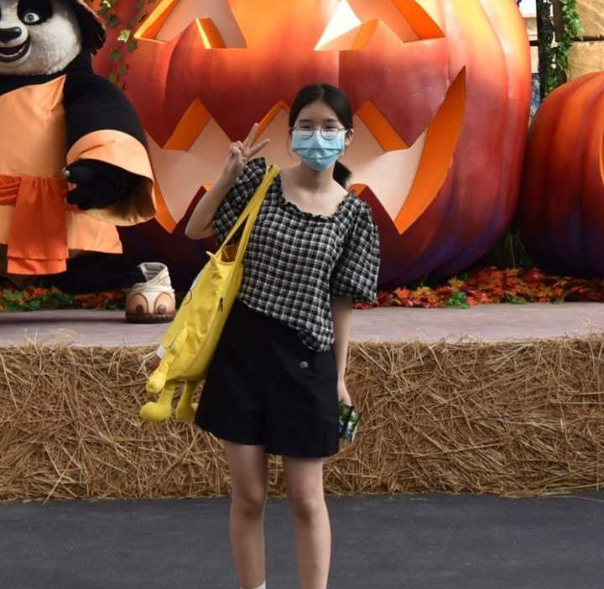
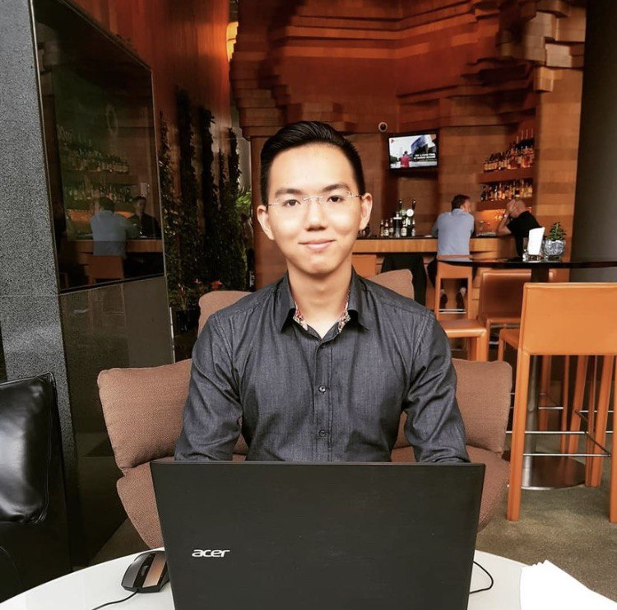
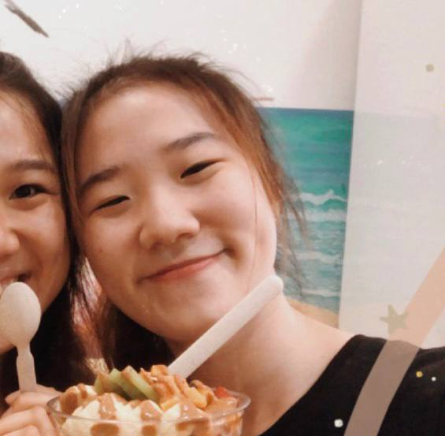
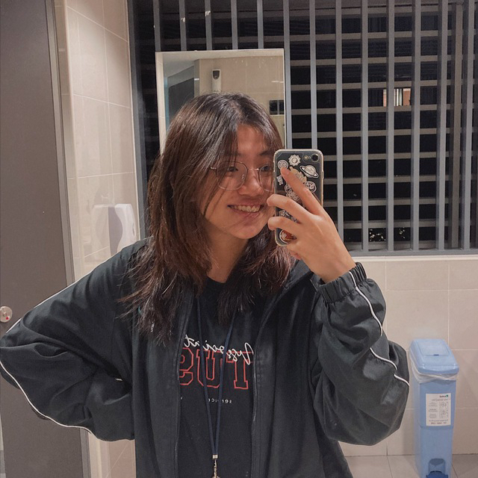
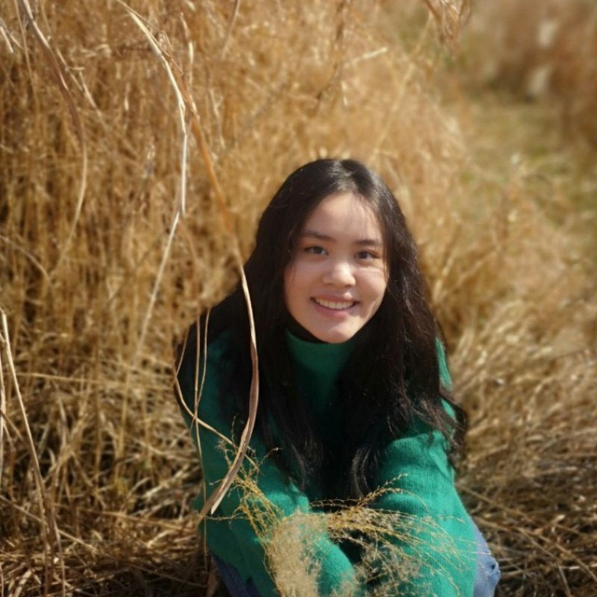
The Team
Ko
pi
m
o
n.
Made in Singapore. For Singapore.
Swapnil
TEAM LEAD
Ruokun
CODE
Yuyue
CODE
Sean
CODE
Shin Hui
DESIGN
Charm
DESIGN
Fuguo
CODE

Slide 2











m
o
Ko
n.
.
pi
The Team
Swapnil
TEAM LEAD
Ruokun
CODE
Yuyue
CODE
Sean
CODE
Charm
DESIGN
Shin Hui
DESIGN
Fuguo
CODE
About Kopimón
Kopimón is pixelised, Singapore-themed, role-playing game with multiplayer capabilities.
A game that is relevant and relatable to Singaporeans of all age groups regardless of their differences.

Slide 3


Swapnil
TEAM LEAD
Ruokun
CODE
Yuyue
CODE
Sean
CODE
Shin Hui
DESIGN
Charm
DESIGN
Fuguo
CODE
The Team
About Kopimón
Kopimón is 2.5D adventure RPG-game set in modern day Singapore, where you venture out to iconic places such as the Esplanade, Marina Bay Sands, and even hawker centres, take on quests and battle with monsters and other players.
Our Motivation & Objective.
To create an application that emulates an experience that is similar to GatherTown & Pokémon but better.
To make the game more relevant and relatable to local context and age groups.
Intuitive to maneuver around in-game.
Instil a sense of belonging towards Singapore.

Slide 4

About Kopimón
Kopimón is 2.5D adventure RPG-game set in modern day Singapore, where you venture out to iconic places such as the Esplanade, Marina Bay Sands, and even hawker centres, take on quests and battle with monsters and other players.
Some people translate it as “good luck”, or “work hard”, but I would translate it as “hang on in there”, because I think it is the closest in spirit to the original. It can be used in a wide variety of circumstances
Our Motivation & Objective.
To create an application that emulates an experience that is similar to GatherTown & Pokémon but better.
To make the game more relevant and relatable to local context and age groups.
.
Intuitive to maneuver around in-game.
Instil a sense of belonging towards Singapore.
Game Features
Single
player
Localisation & Quest.
Multiplayer
Fight scenes

Slide 5
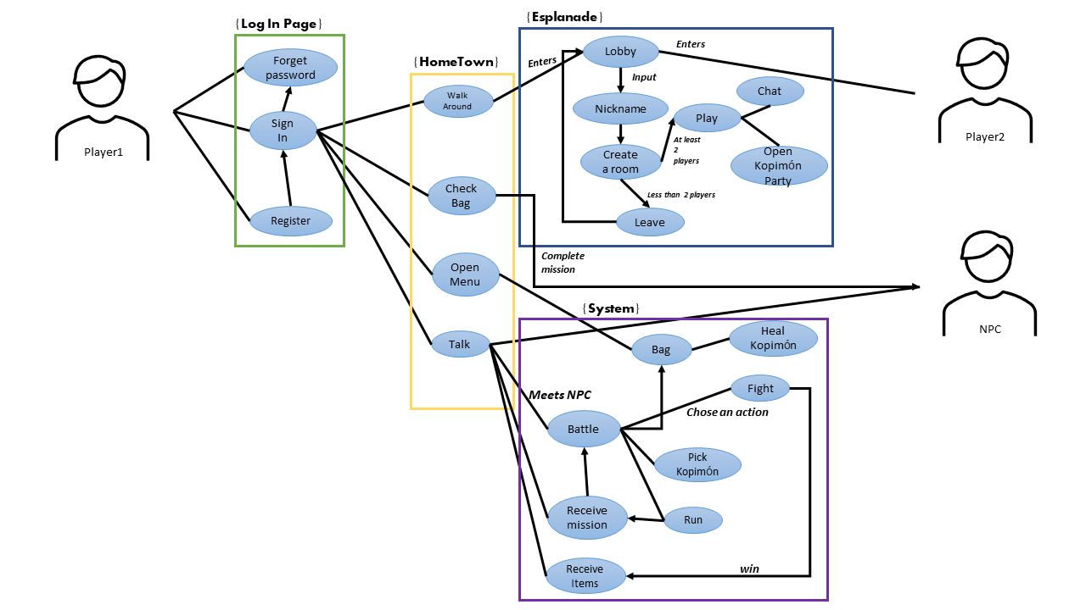
Game Features
Single
player
Localisation & Quest.
Battle system.
Multiplayer

Slide 6
Gear.
Some people translate it as “good luck”, or “work hard”, but I would translate it as “hang on in there”, because I think it is the closest in spirit to the original
Our Motivation & Objective.
.
Game Features
Single
player
Multiplayer
Localisation & Quest.
Battle system.
Single-player mode.

Slide 7
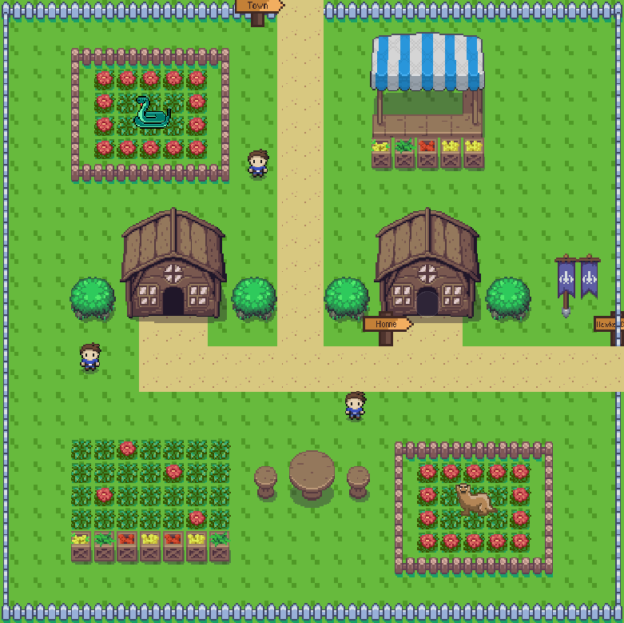
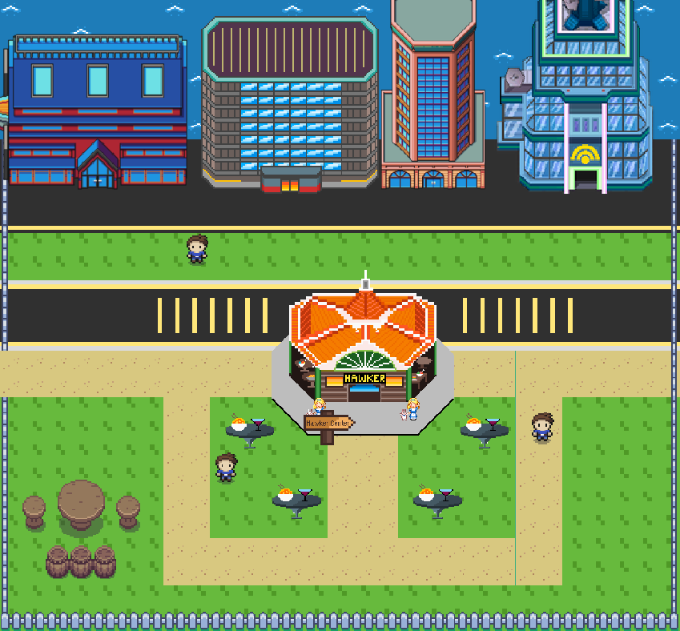
Single
player
Localisation & Quest.
Multiplayer
Battle system.
Game Features
Some people translate it as “good luck”, or “work hard”, but I would translate it as “hang on in there”, because I think it is the closest in spirit to the original. It can be used in a wide variety of circumstances
Single-player mode.
Exploration
Turn-based battle
Character interaction
.
Multiplayer.

Slide 8
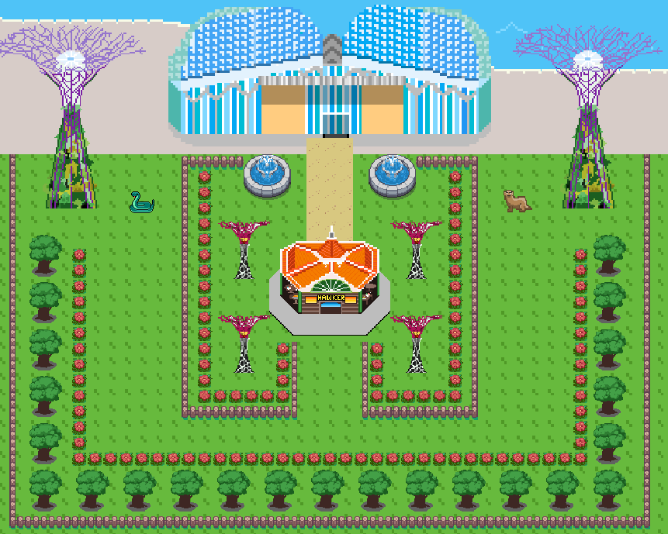
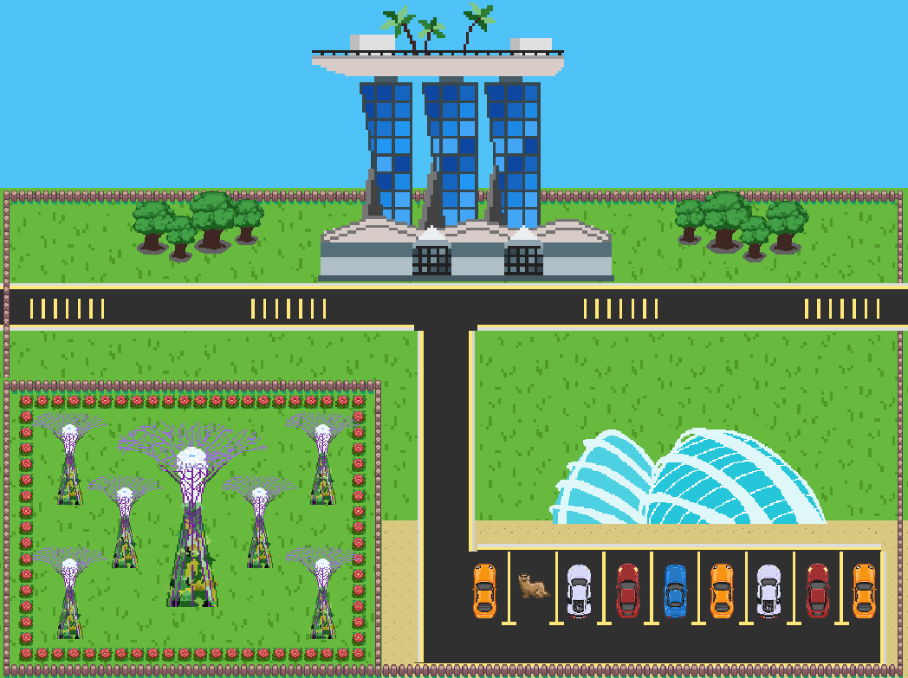
Exploration

Slide 9
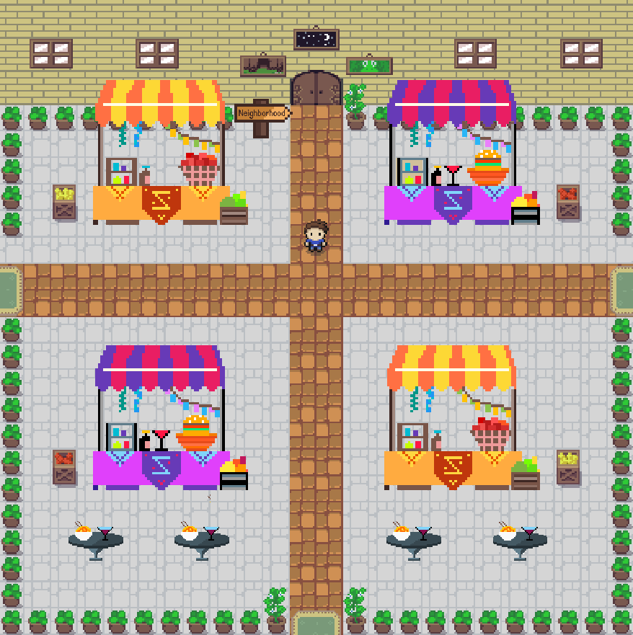
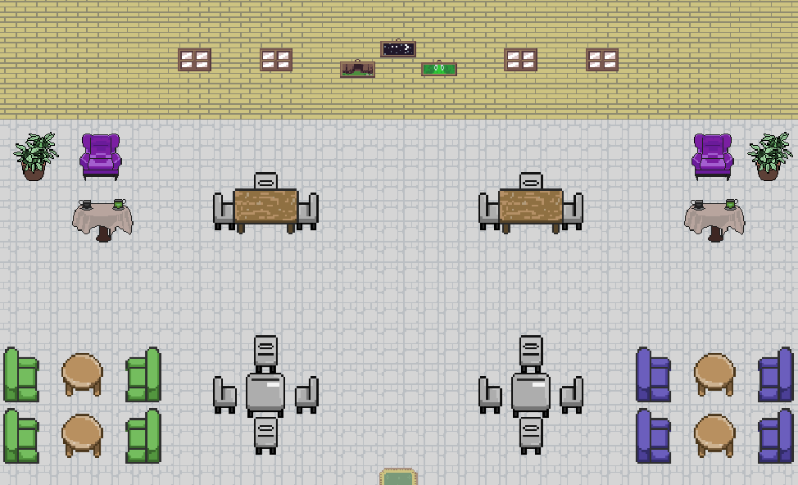
Exploration

Slide 10
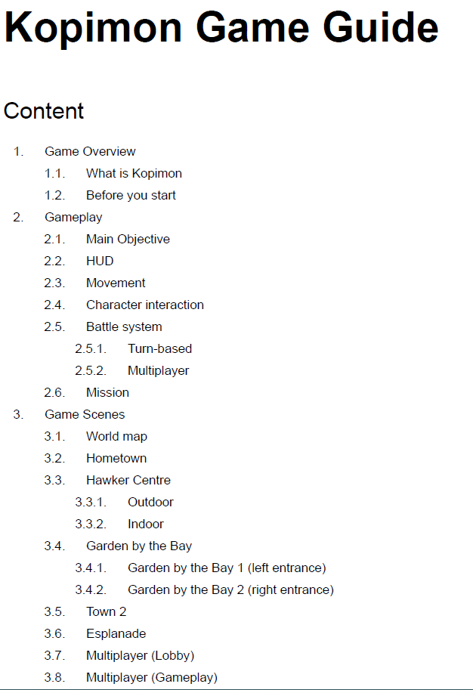
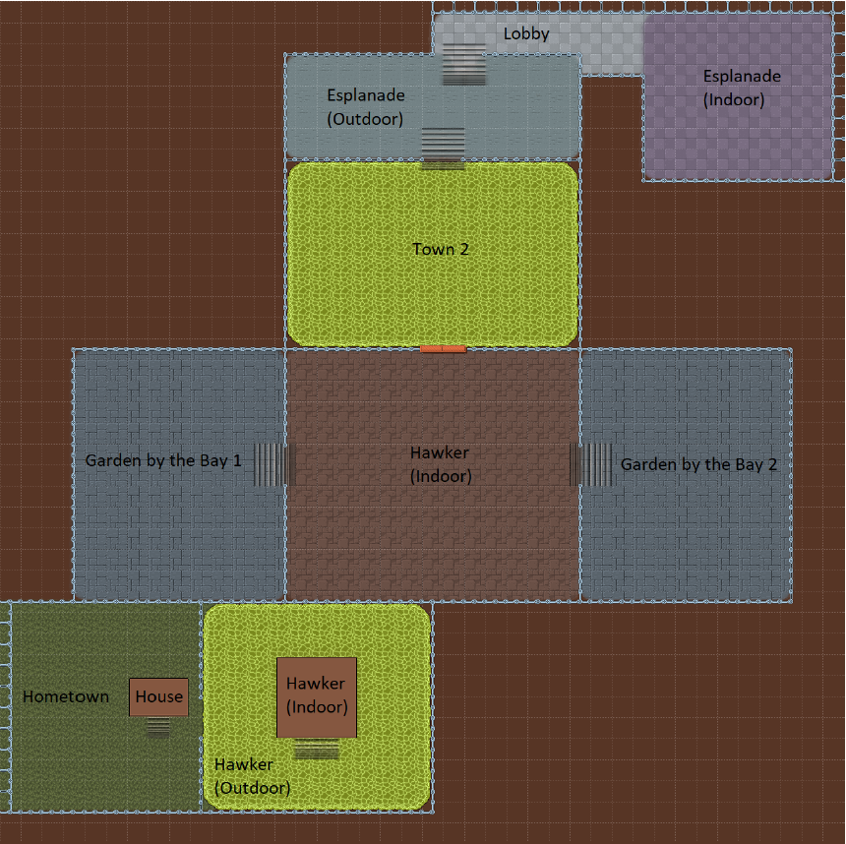
Multiplayer.
Exploration
Room character & character selection
Room character & character selection
Shooting game
Chat function
Shooting game
Chat function
Results board
Connected scenes for a smoother experience
Game Guide
Results board
Multiplayer.

Slide 11
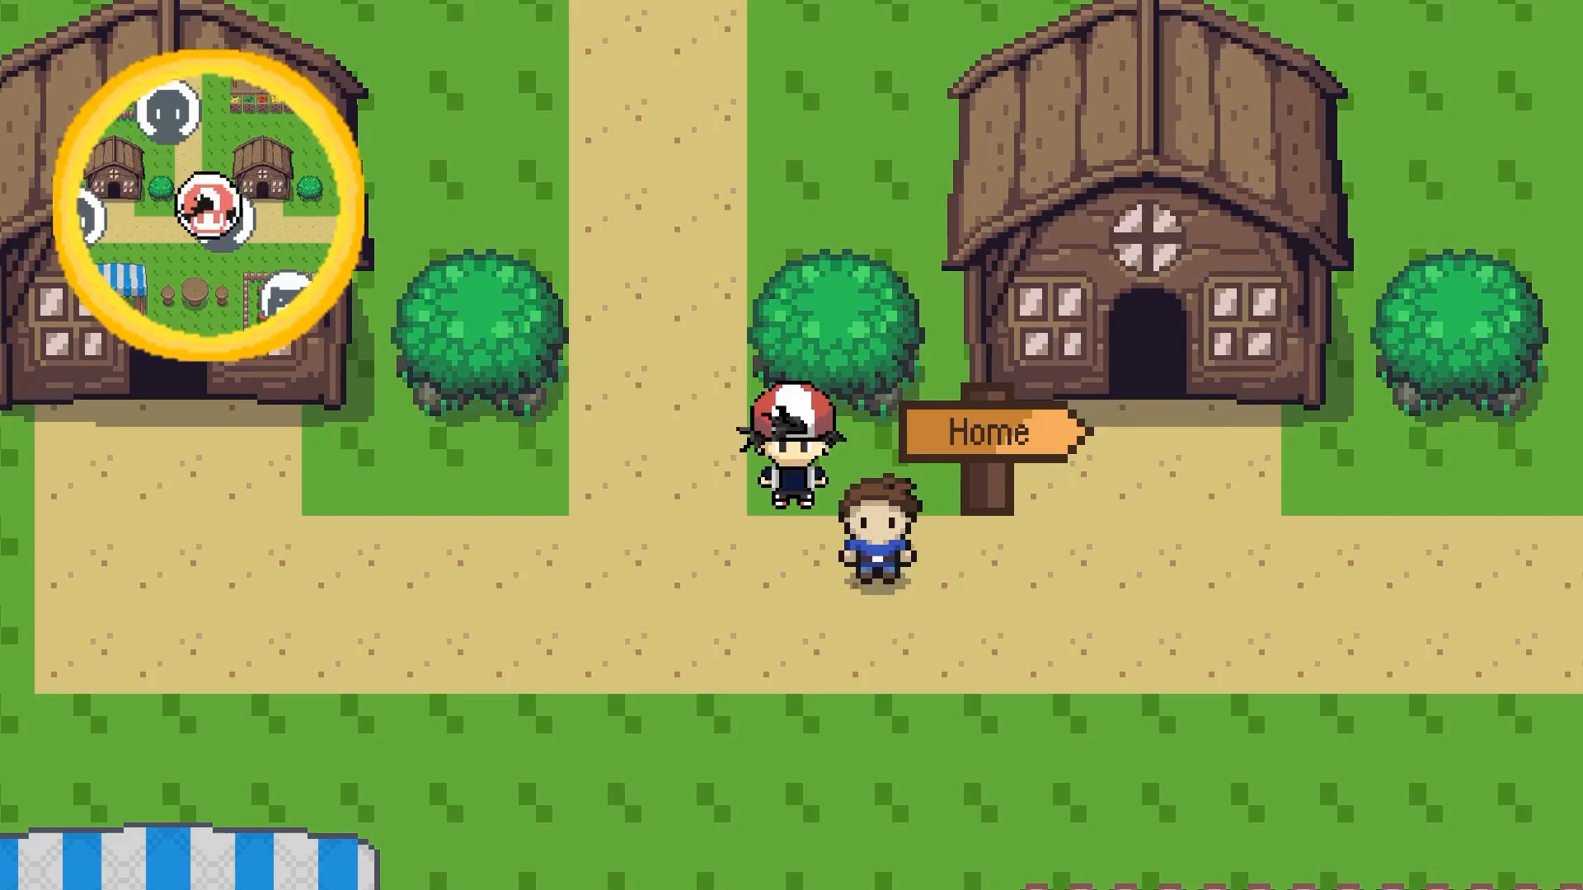

Slide 12
Single-player mode.
Multiplayer.
Room creation & character selection
Chat function
Shooting game
Results board
Localisation & Quest.
Some people translate it as “good luck”, or “work hard”, but I would translate it as “hang on in there”, because I think it is the closest in spirit to the original

Slide 13
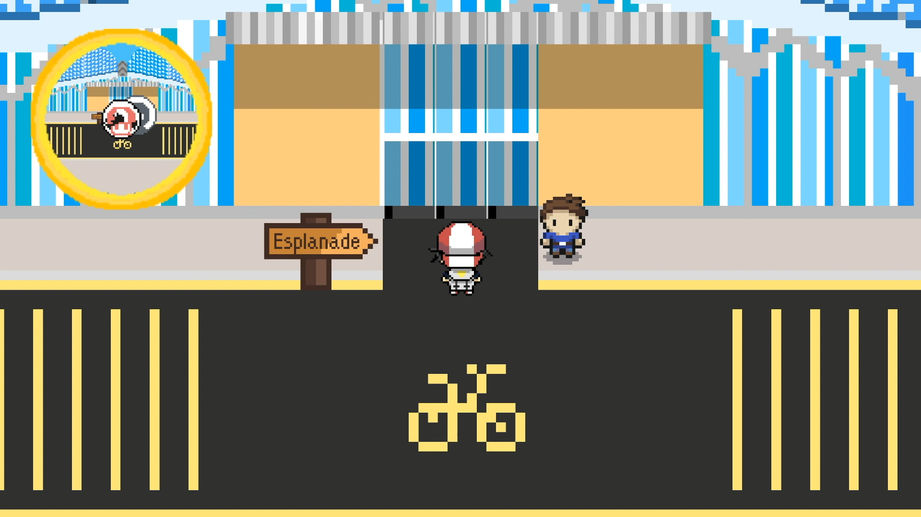
Localisation.
Multiplayer.
Get the Merlion as your starter pet.
Interact with local, wild animals
Explore Singapore landmarks.
Room character & character selection
Quest.
Chat function
Shooting game
Get ART test kit.
Exchange test kit for vaccine.
Results board
Unlock multiplayer function and interact with other players!

Slide 14
Multiplayer.
Localisation.
Get the Merlion as your starter pet.
Interact with local, wild animals
Explore Singapore landmarks.
Quest.
Get ART test kit.
Exchange test kit for vaccine.
Unlock multiplayer function and interact with other players!
Fight scenes.

Slide 15
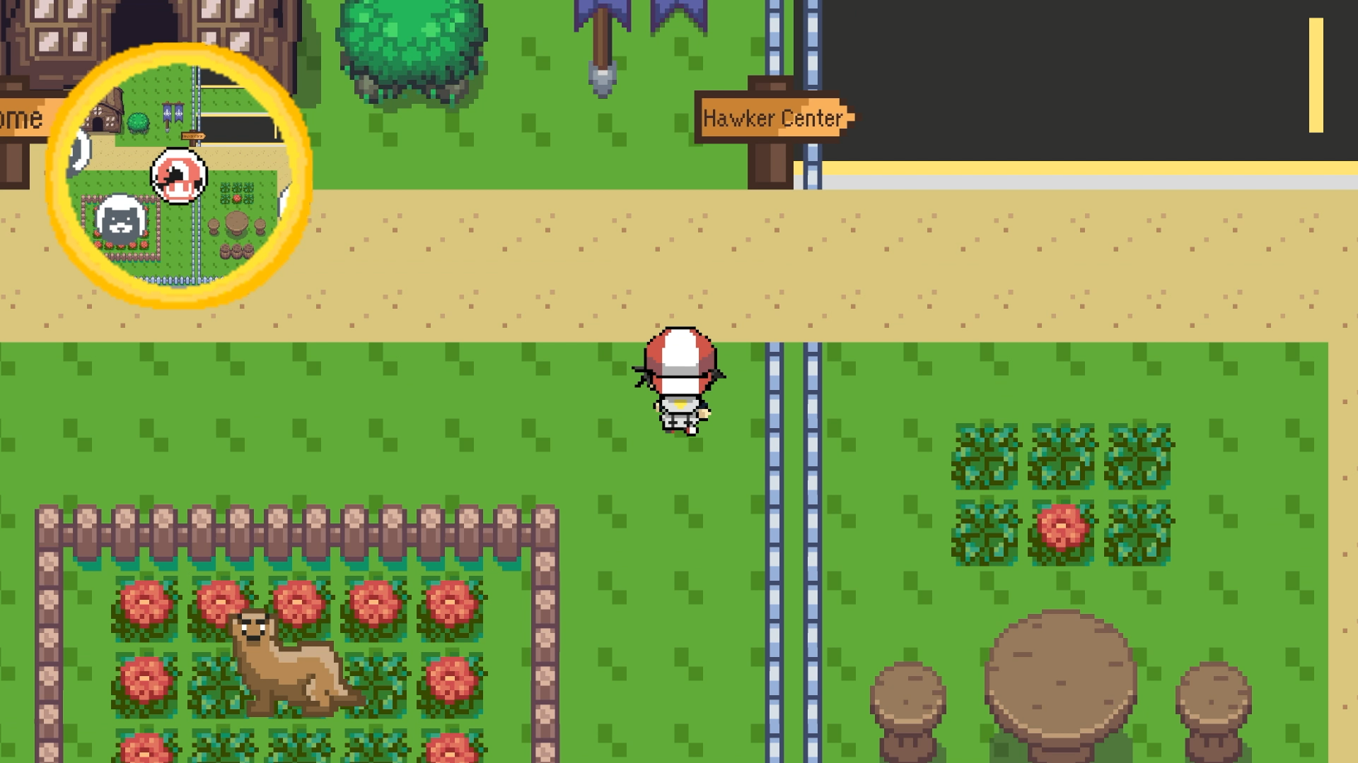
Localisation.
Battle system.
Get the Merlion as your starter pet.
Interact with local, wild animals
Explore Singapore landmarks.
Quest.
Get ART test kit.
Exchange test kit for vaccine.
Unlock multiplayer function and interact with other players!
Status conditions and level up.
Stats boosting algorithm.
Multiplayer battle.
Catching wild kopimons.

Slide 16
Gear.
Some people translate it as “good luck”, or “work hard”, but I would translate it as “hang on in there”, because I think it is the closest in spirit to the original
Localisation.
Quest.
.
Battle system.
Stats boosting algorithm.
Status conditions and level up.
Catching wild kopimons.
Multiplayer battle.
Ember (Fire-Type Move):
- Deals damage.
- Causes burn status change.
The Artwork
Grown (Sound Move)
- Does not deal damage.
- Causes drop in attack.

Slide 17
Gear.
Some people translate it as “good luck”, or “work hard”, but I would translate it as “hang on in there”, because I think it is the closest in spirit to the original
.
Battle system.
Ember (Fire-Type Move):
- Deals damage.
- Causes burn status change.
Growl (Sound Move)
- Does not deal damage.
- Causes drop in attack.

Slide 18
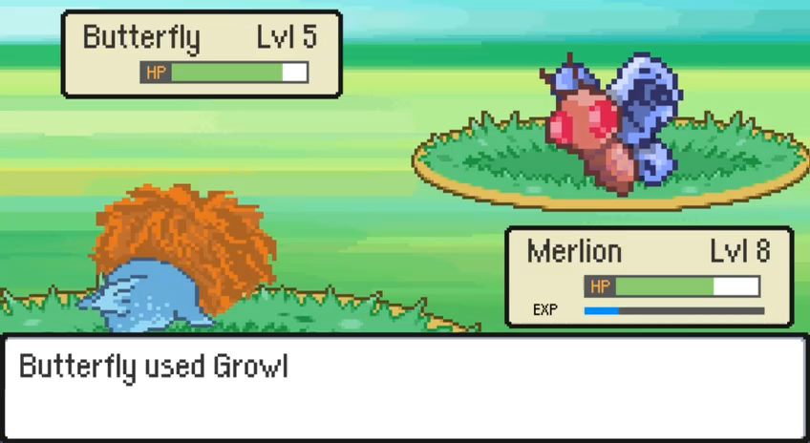
Battle system.
The Artwork
Tile-based game with pixel art (32x32, 64x64 and 128x128 bit.
Status conditions and level up.
Stats boosting algorithm.
Elements meant to reflect the local elements in Singapore.
Multiplayer battle.
Catching wild kopimons.

Slide 19
The Artwork
Tile-based game with pixel art (32x32, 64x64 and 128x128 bit.
Elements meant to reflect the local elements in Singapore.

Slide 20


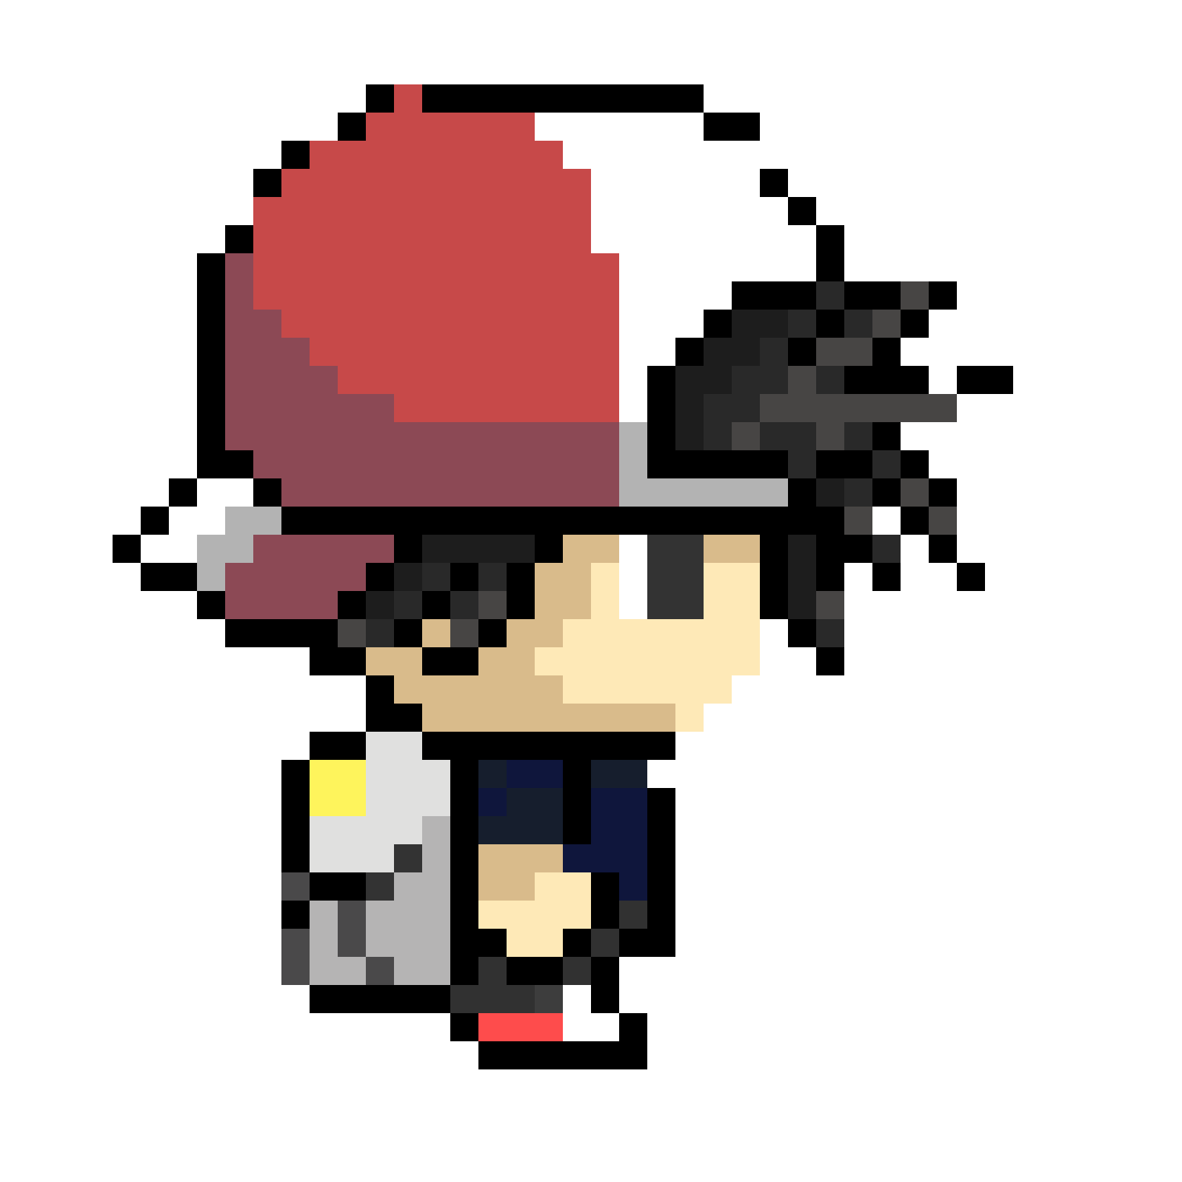
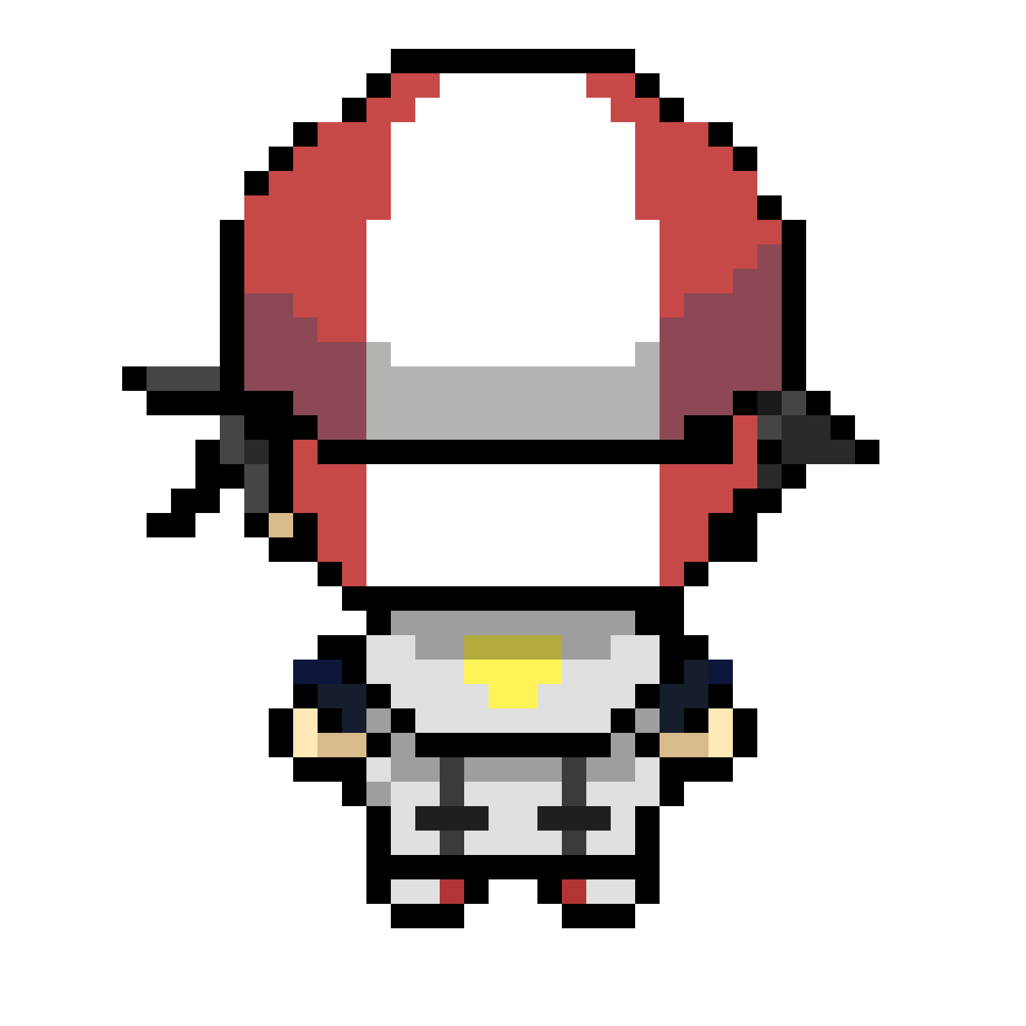
The Artwork
Tile-based game with pixel art (32x32, 64x64 and 128x128 bit.
Elements meant to reflect the local elements in Singapore.

Slide 21
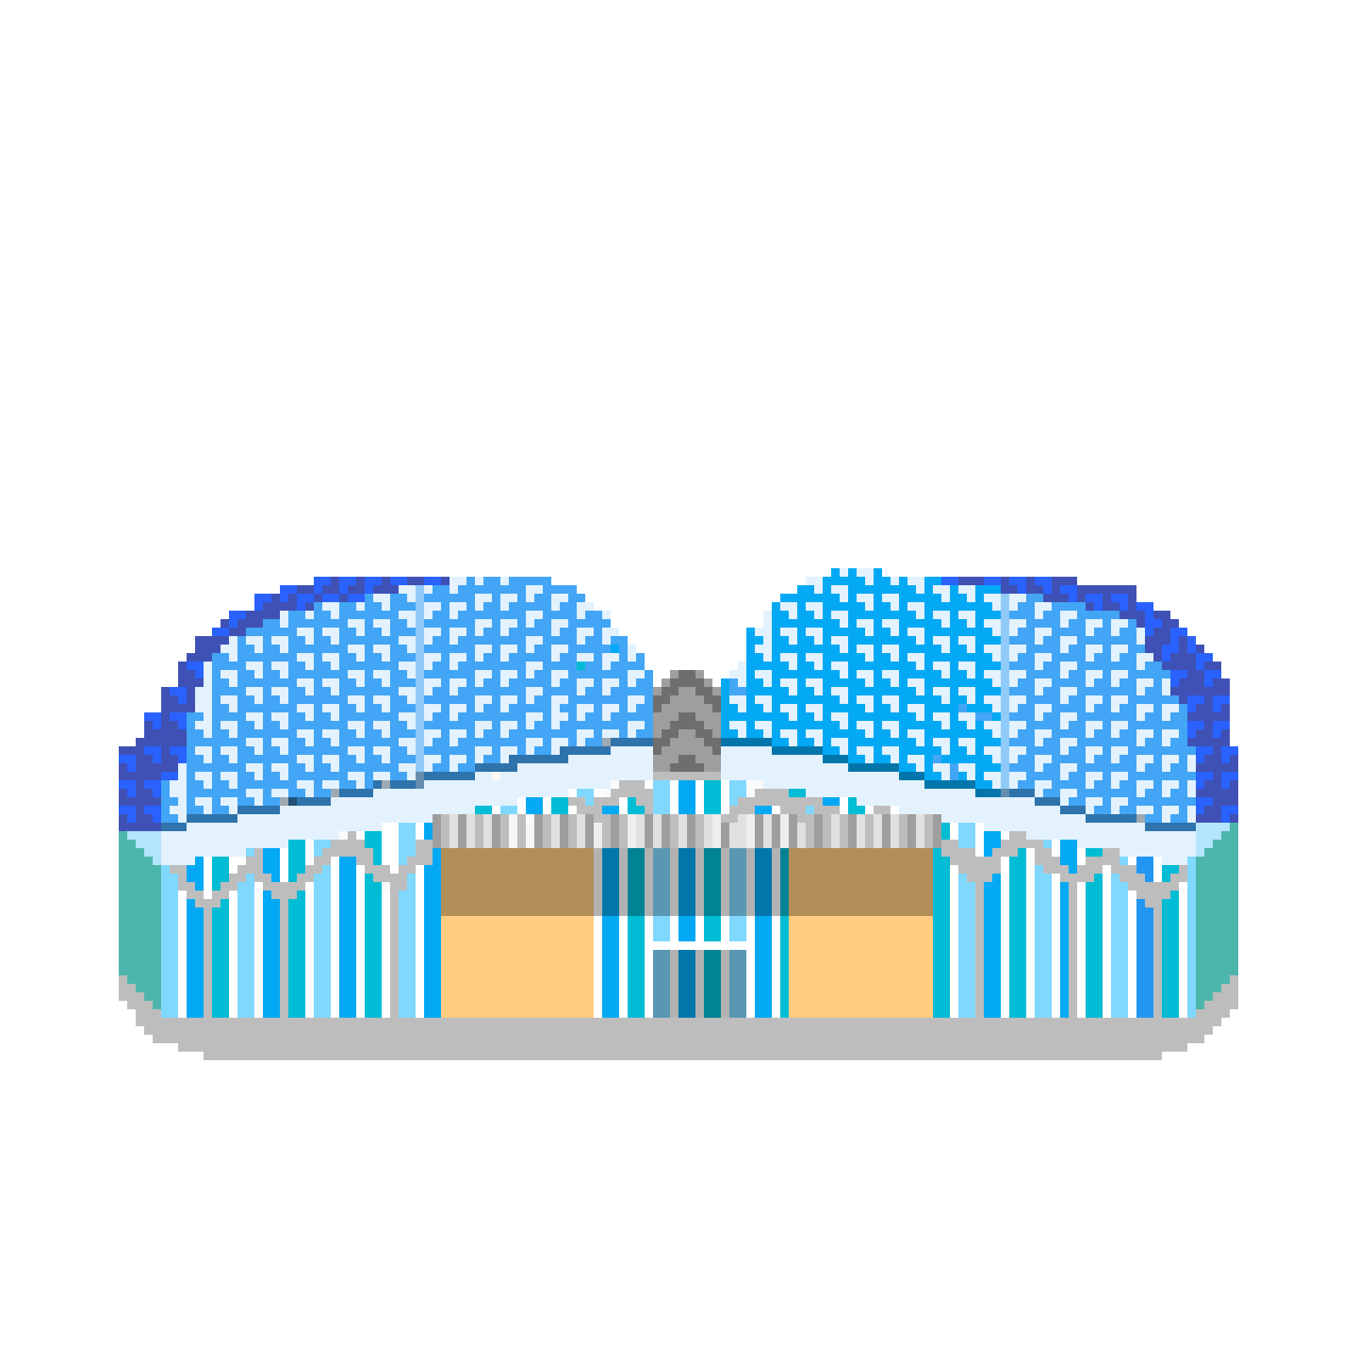
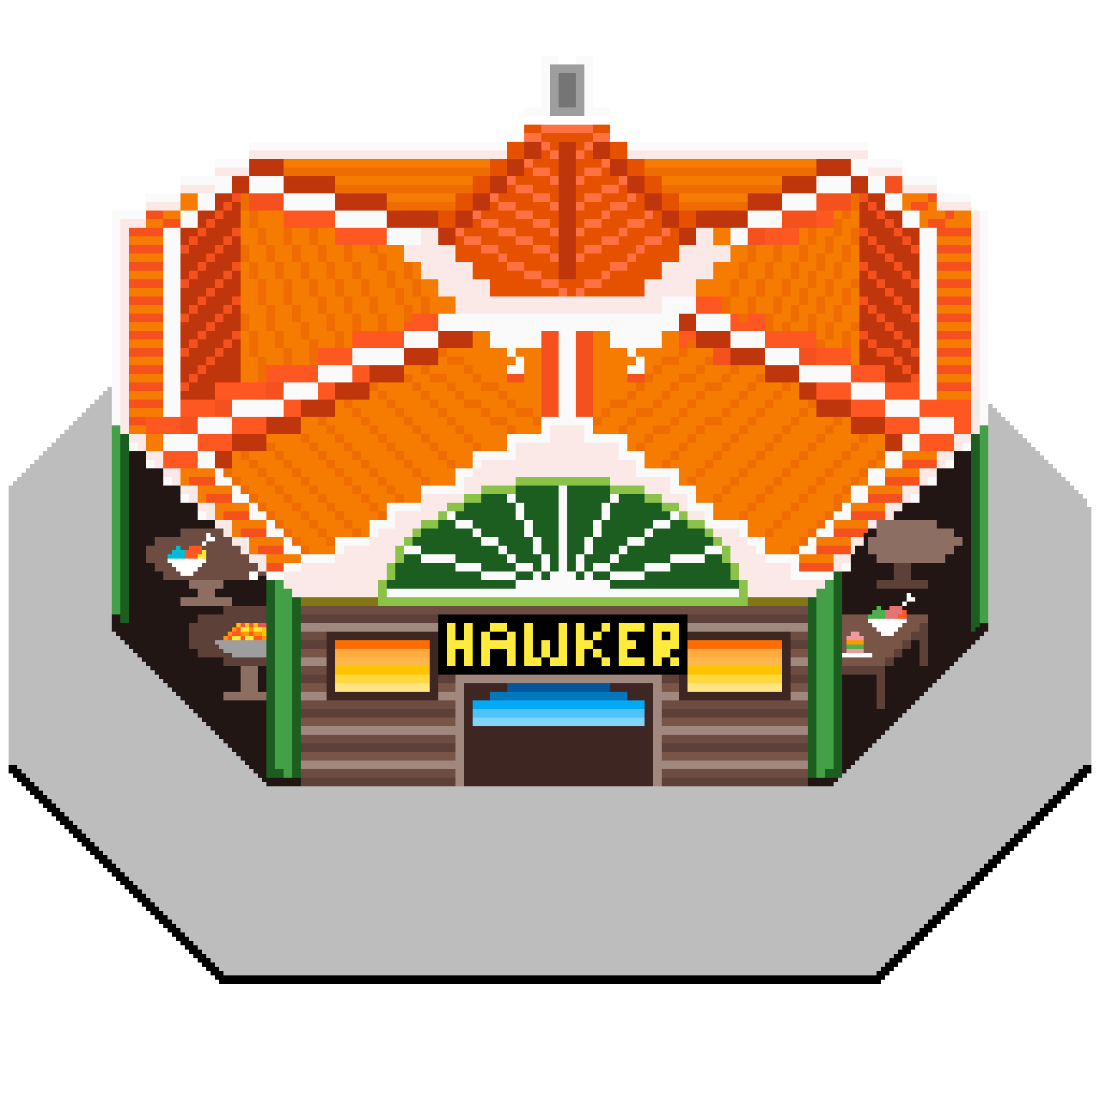
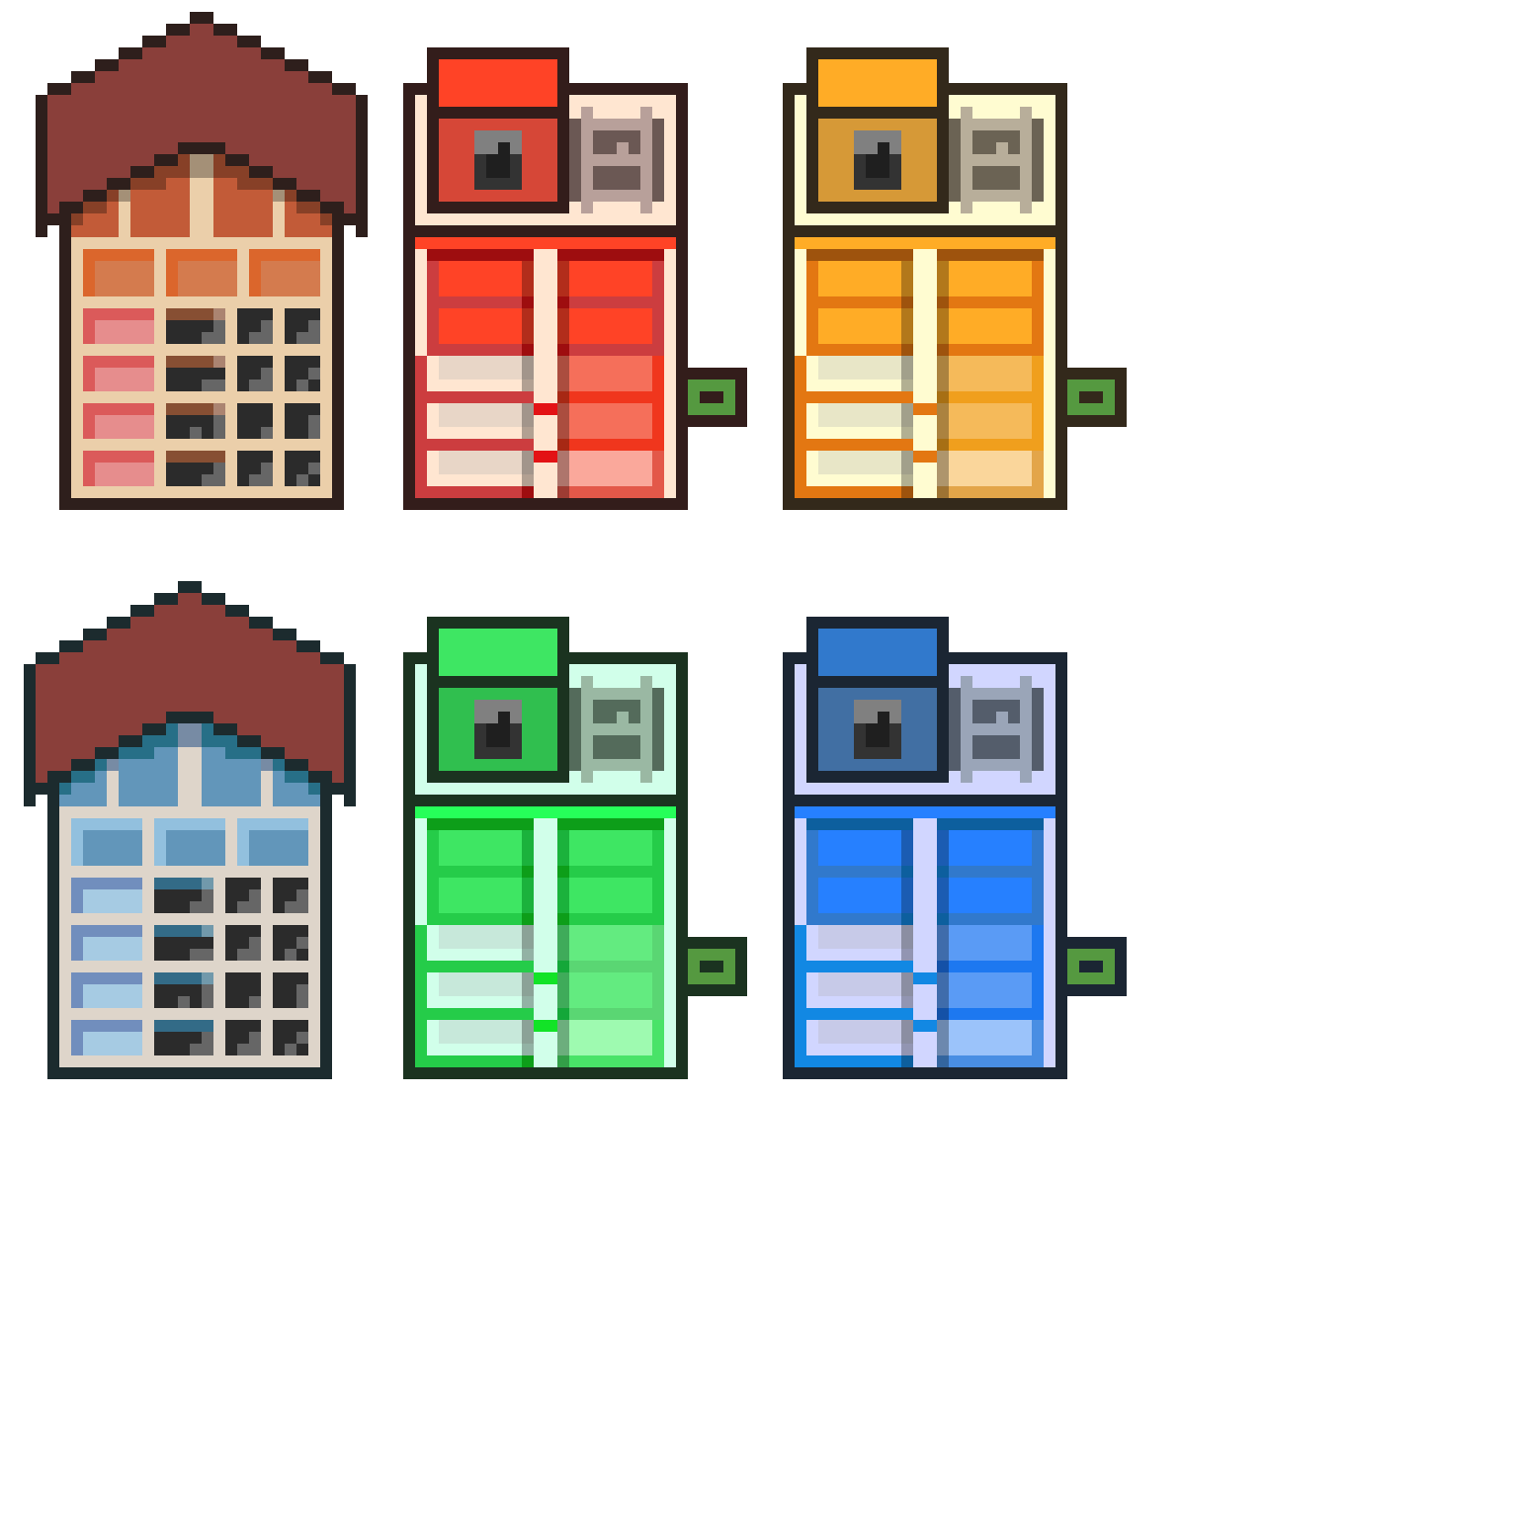

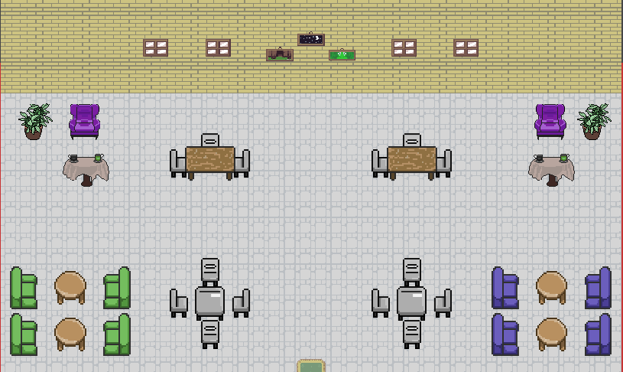
The Artwork
LIVE DEMO

Slide 22


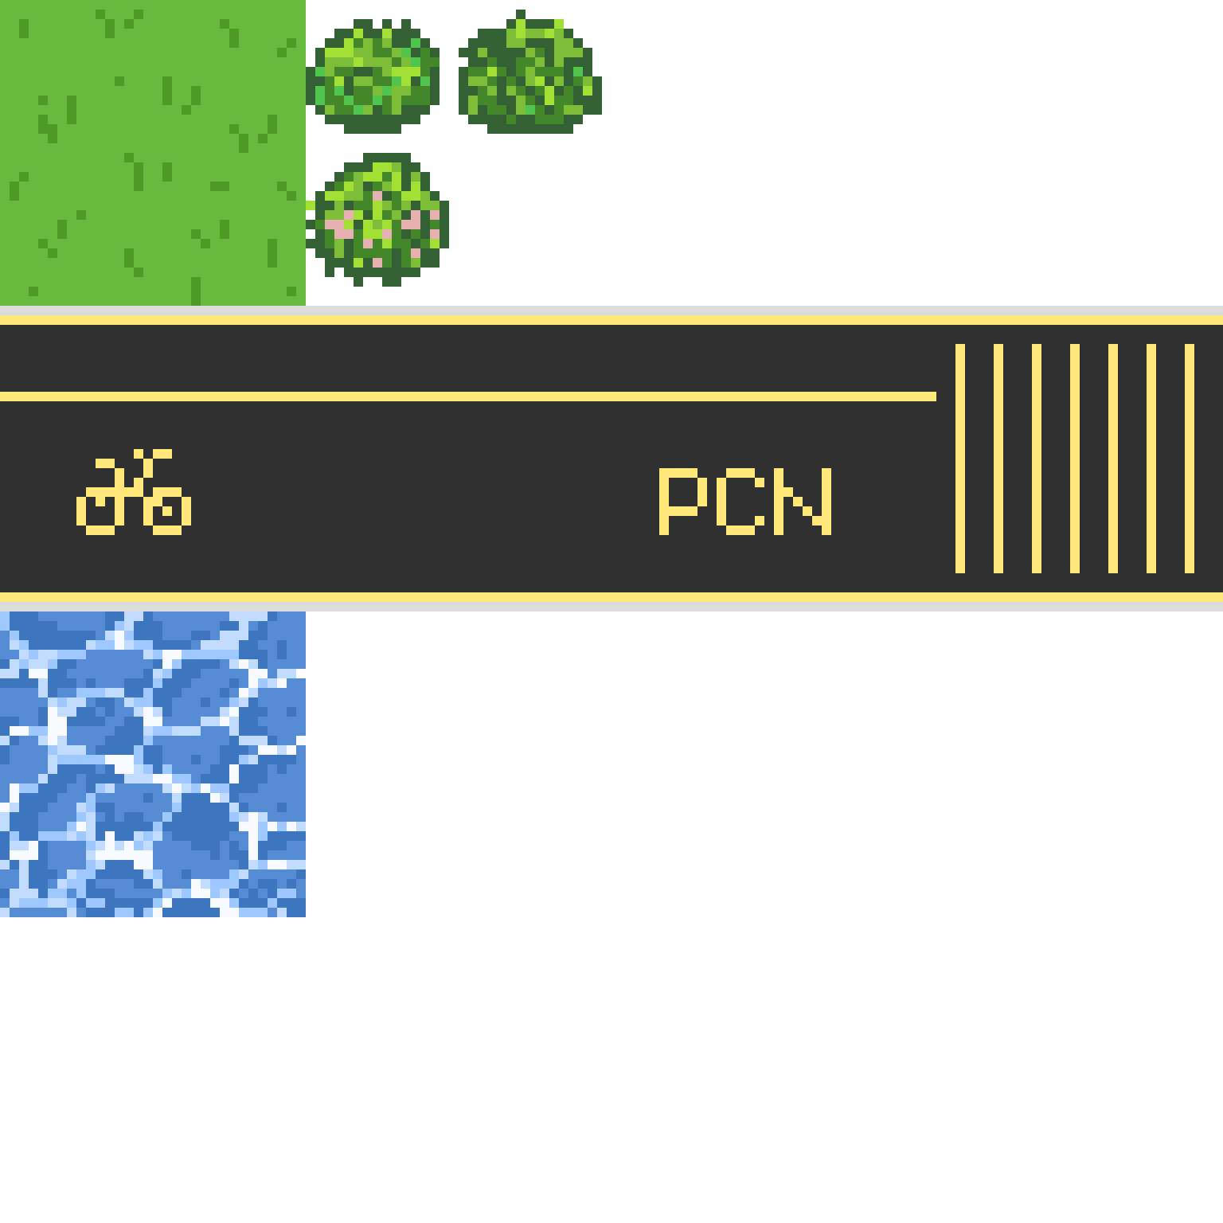
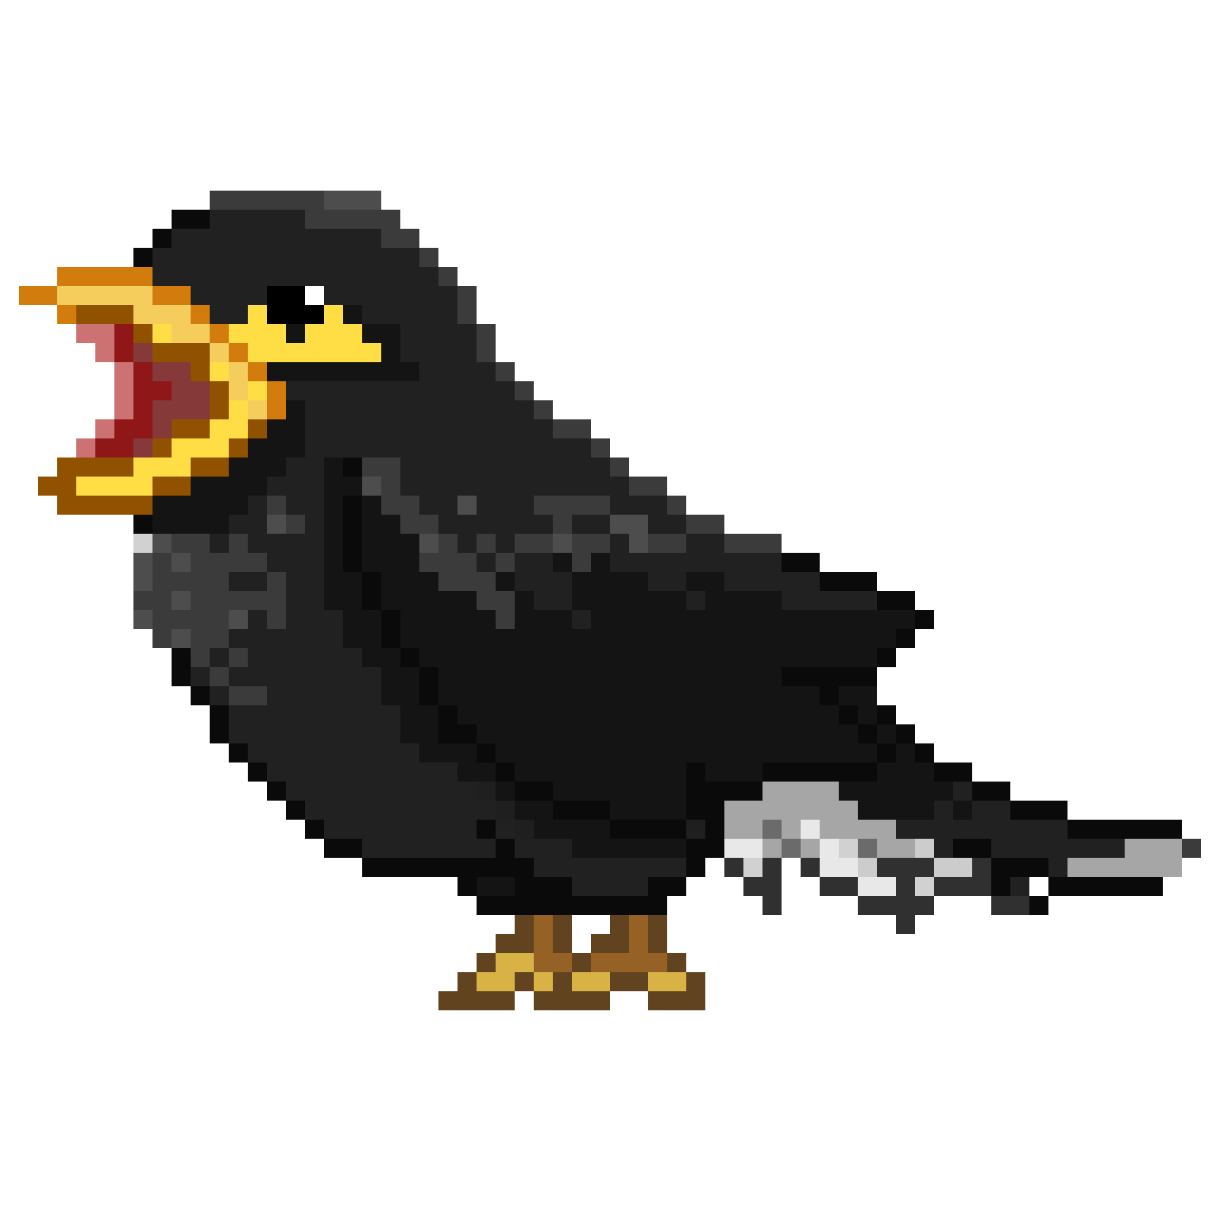

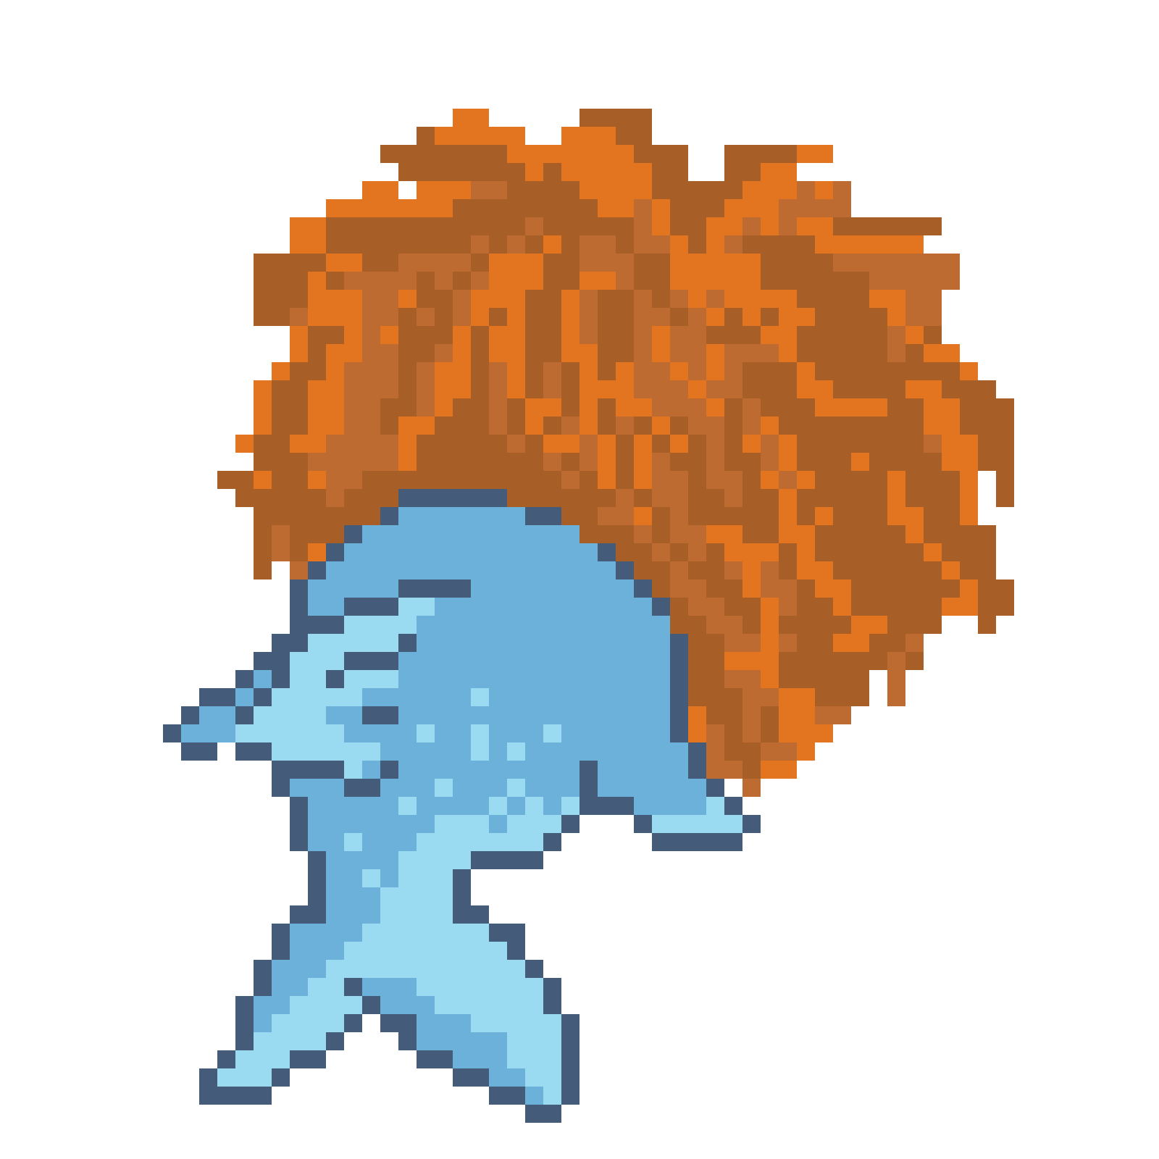
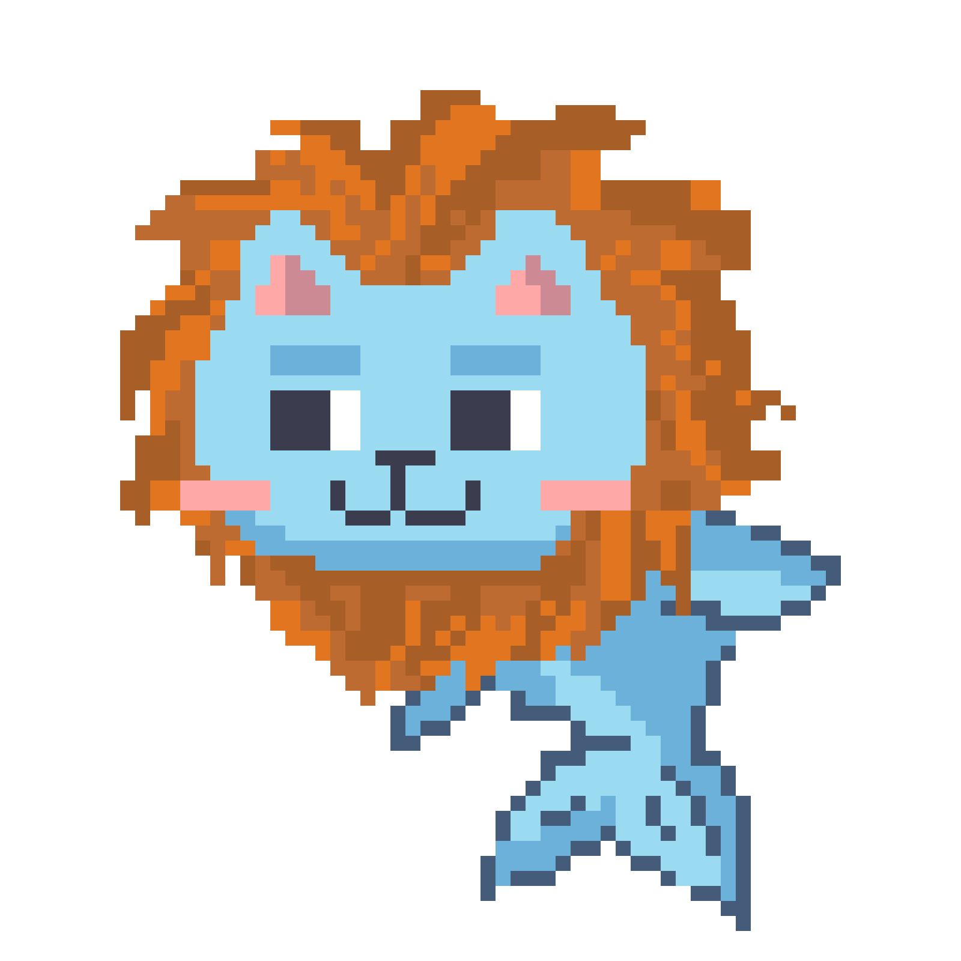
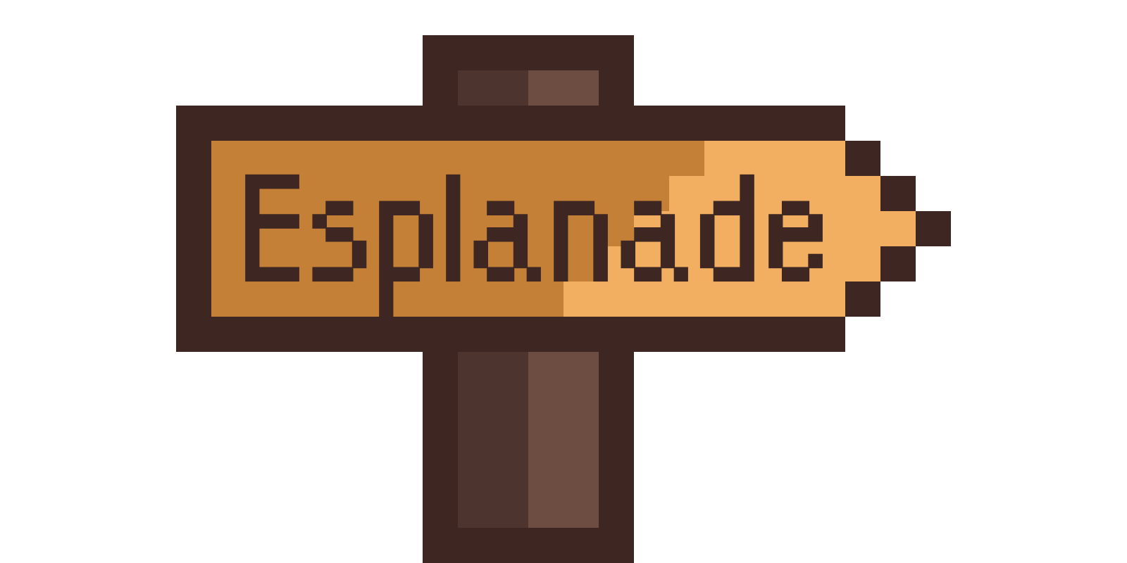
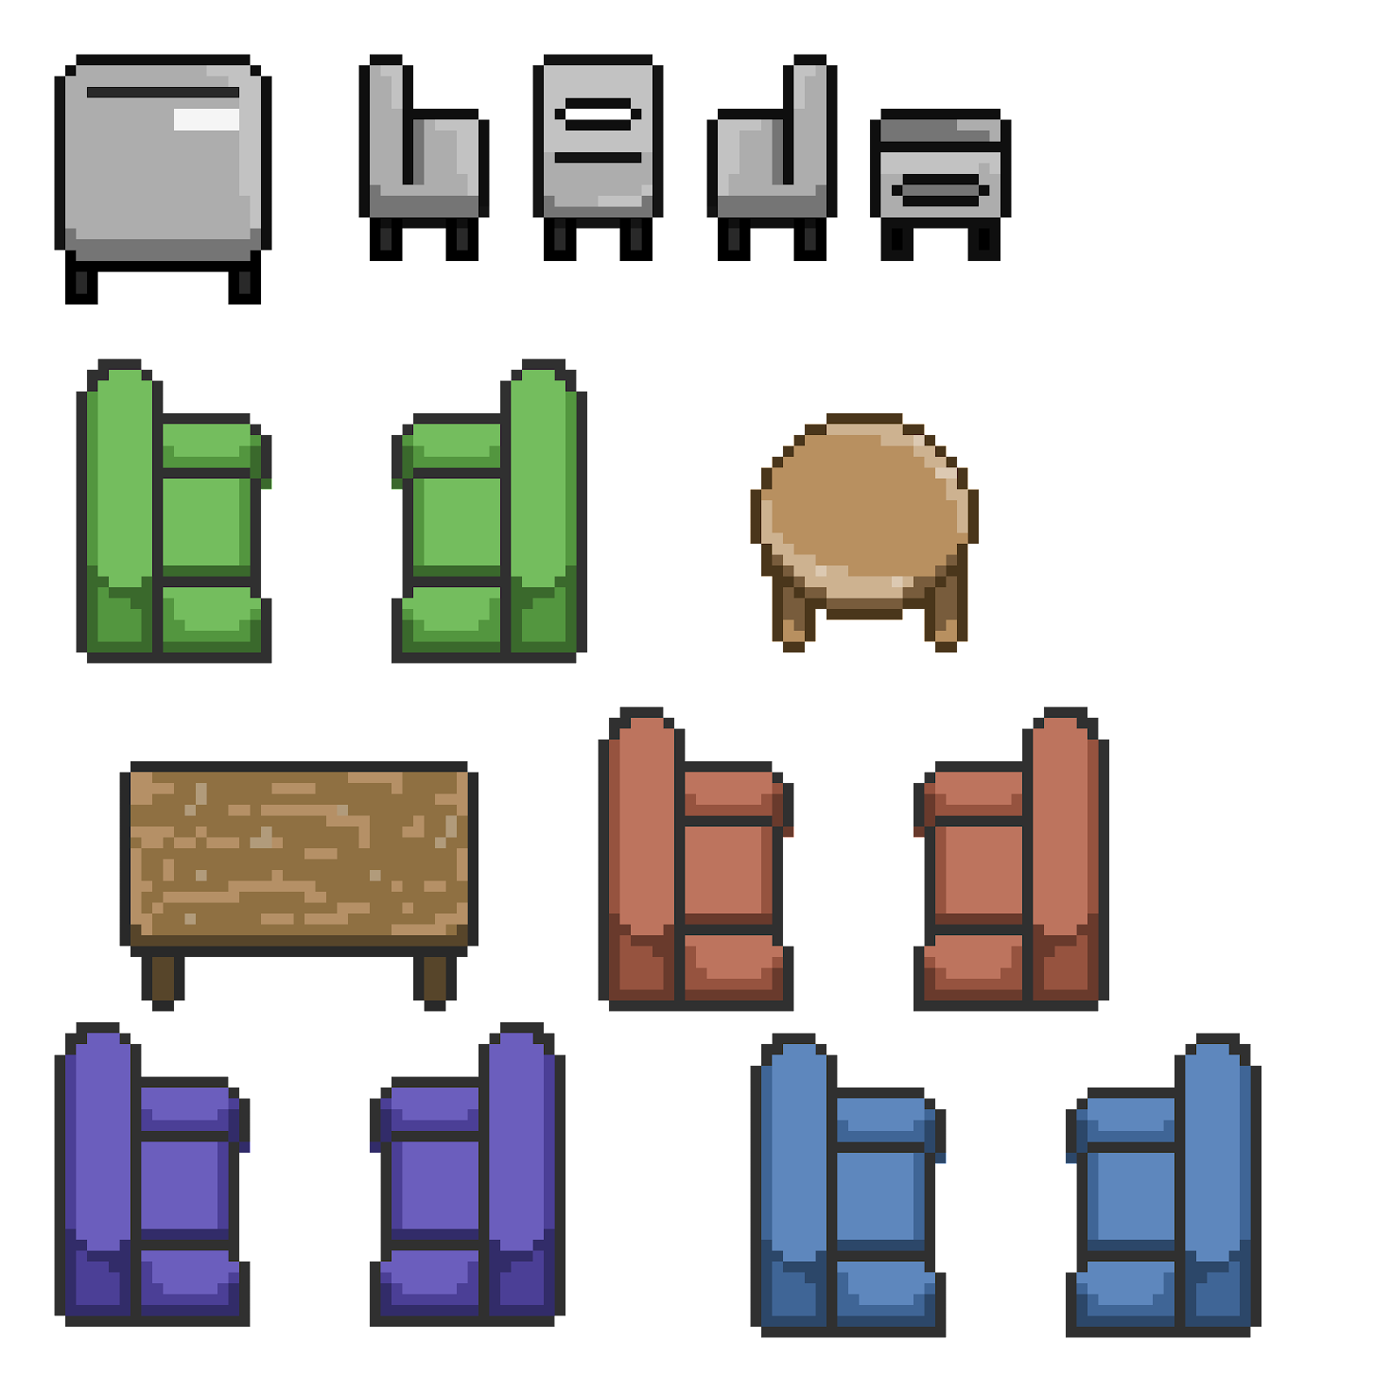
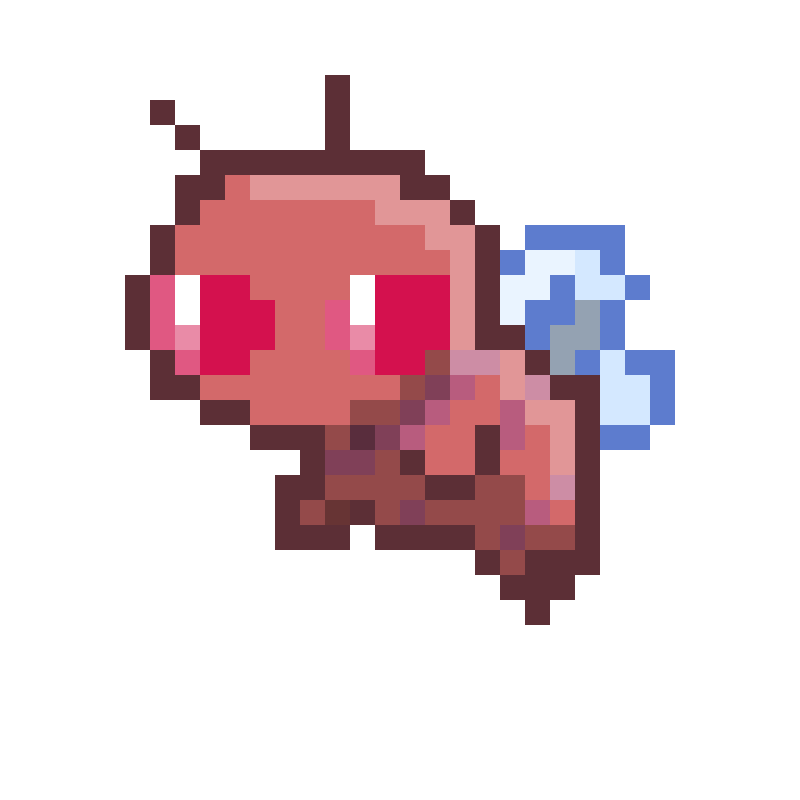
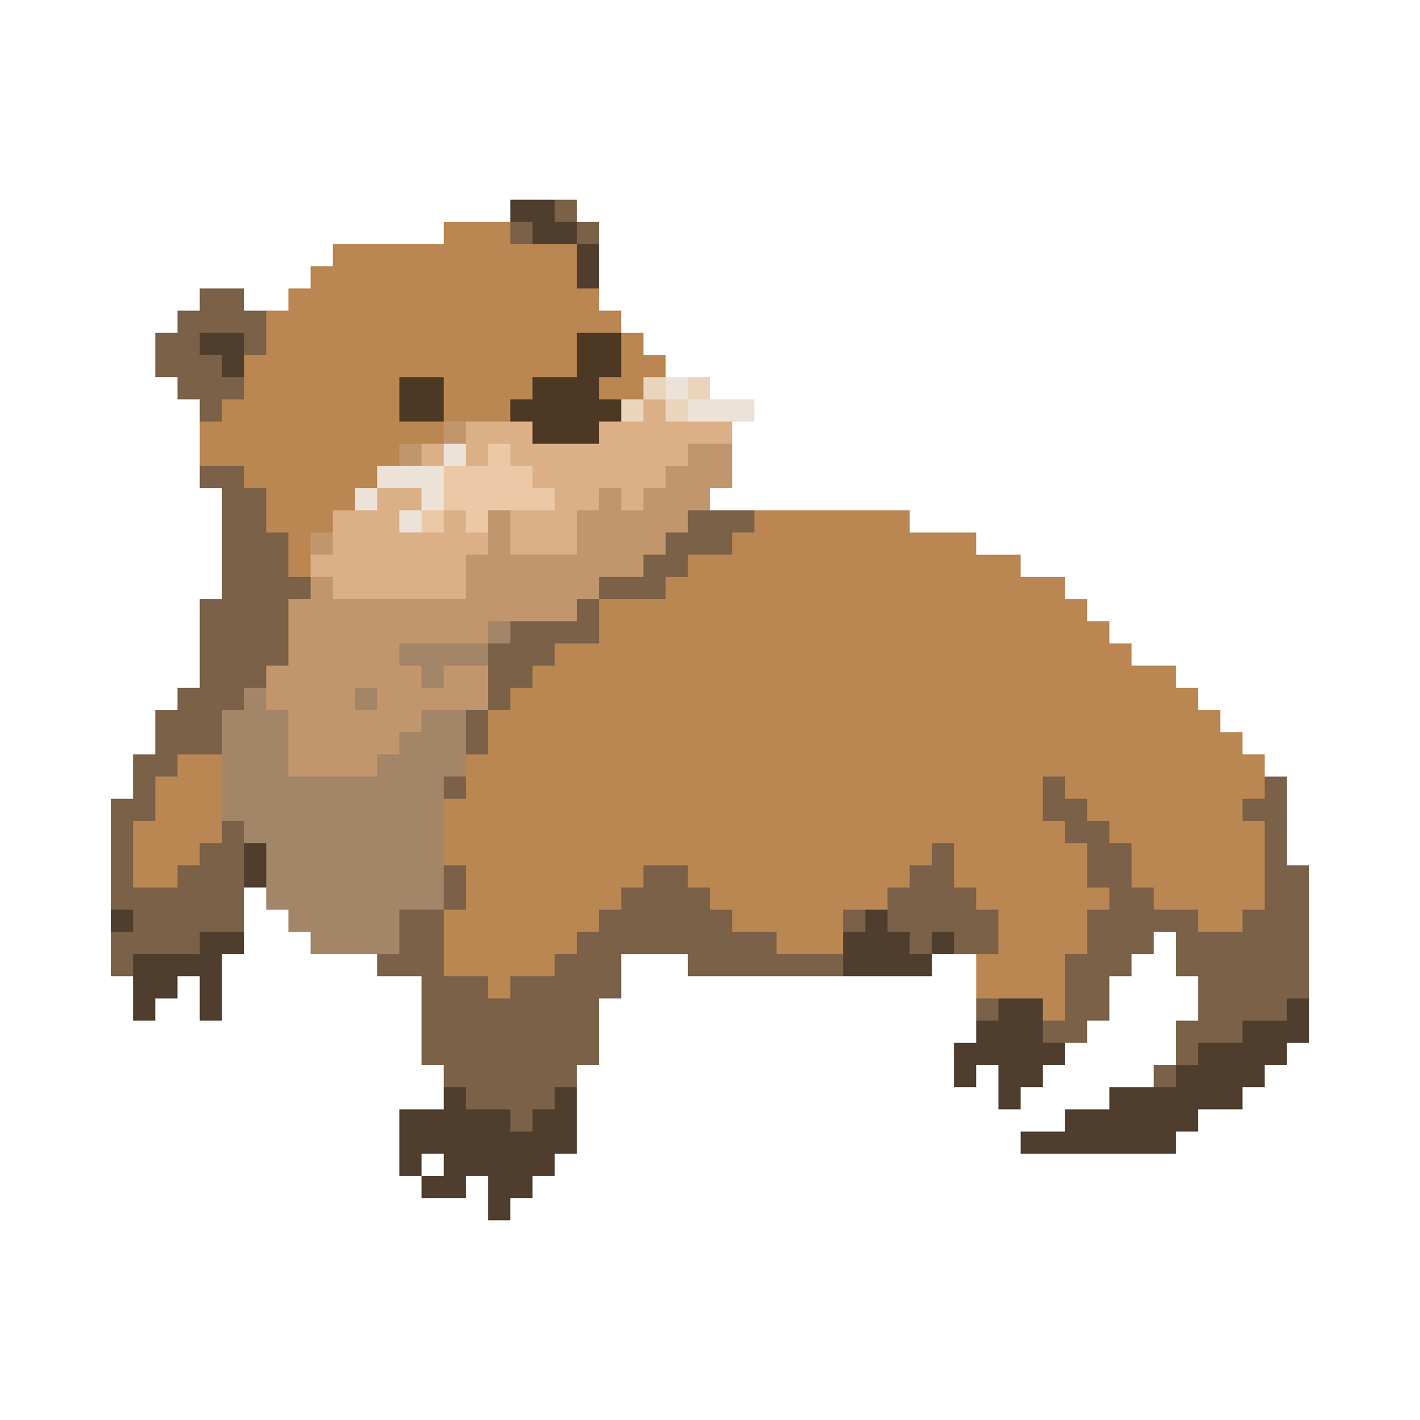
The Artwork
Unity Collaborate
Photon Engine
Tools used.
Unity3D
Firebase Authentication
GitHub
Pixil Art

Slide 23
LIVE DEMO
Some people translate it as “good luck”, or “work hard”, but I would translate it as “hang on in there”, because I think it is the closest in spirit to the original. It can be used in a wide variety of circumstances
Tools used.
Unity
Unity Collaborate
+
THANK YOU
Firebase Authentication
Pixil Art
GitHub
.
Photon Engine

Slide 24
Tools used.
Unity Collaborate
THANK YOU
+
Photon Engine
Unity3D
GitHub
Firebase Authentication
Pixil Art

